Slide 1
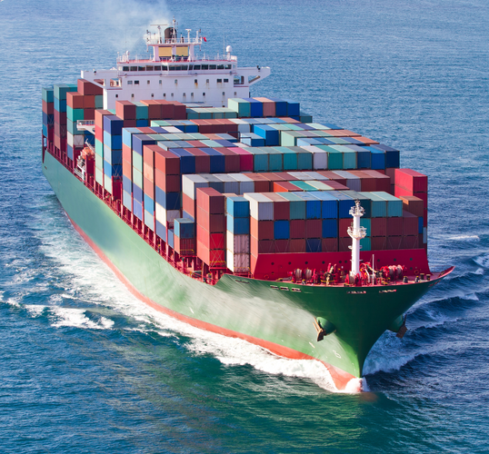


Funding biosecurity systems efficiently, fairly and sustainably
Susie Hester
Gary Stoneham & Arthur Campbell
Presentation to ICBI 2023
1-4 May 2023, Christchurch
https://citrusaustralia.com.au/news/latest-news/xylella-a-global-threat
https://www.thomasnet.com/insights/container-shipping-by-the-numbers/

Slide 2
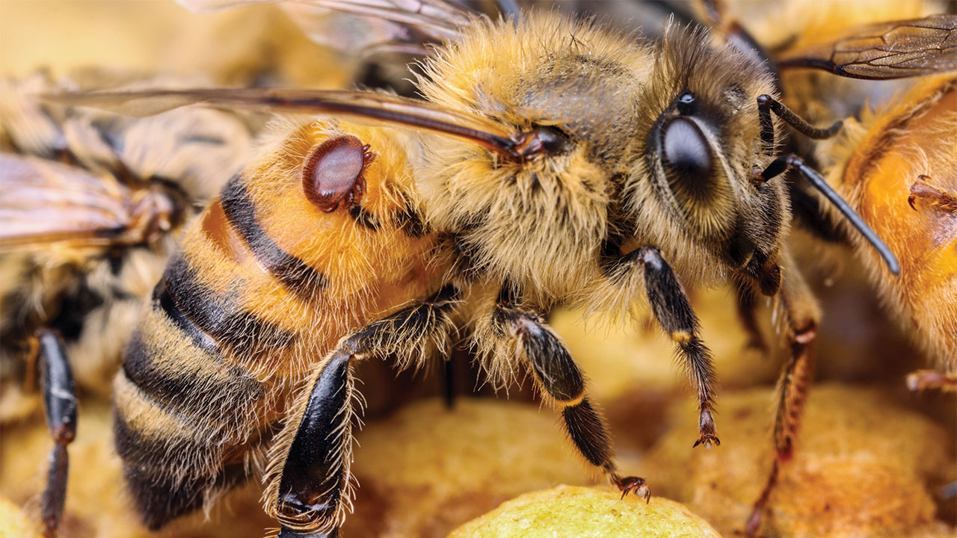
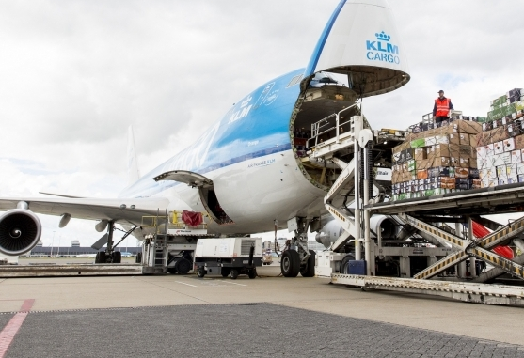
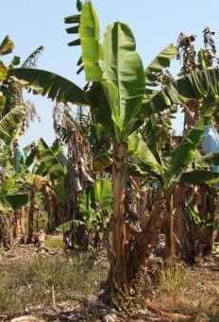
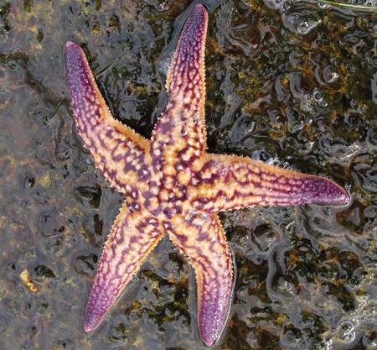
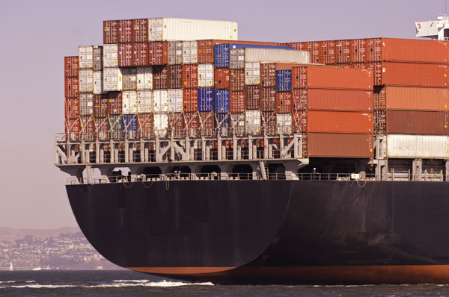
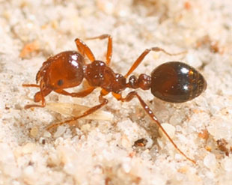



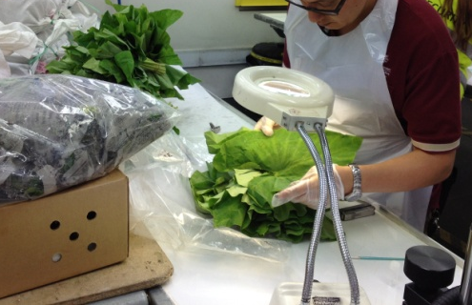



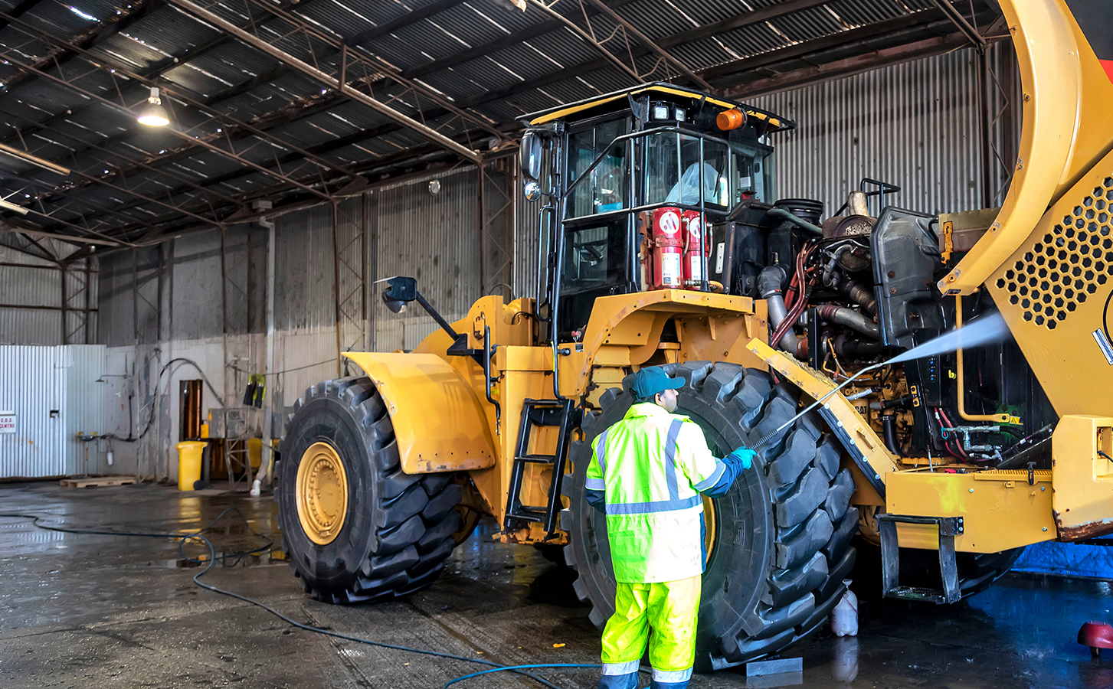

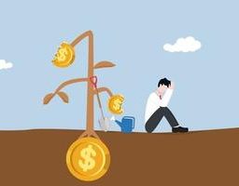

Current biosecurity systems …

Slide 3

Current biosecurity systems …
  Risk creators do not contribute to the cost of responding to the pests and diseases they inadvertently introduce
  introductions of new pests are a negative side effect of trade
  costs of responding funded by taxpayers, affected industries
  not fair, sustainable or efficient
  The true cost of importing should include the risk of an introduction
  Import rules do not provide an incentive for an importer to consider impact of a potential pest introduction

Slide 4
Solution: biosecurity risk insurance
  Risk creators required to purchase insurance from government-run insurance agency
  Premiums based on level of risk: higher premiums for higher-risk imports/vessels.
  Biosecurity risk insurance premiums determined by actuaries
  Premiums pooled by insurance agency
  Funds for response if/as they occur, and surveillance (attribution of losses not required)
  Raises revenue that scales with exposure to threats, volume of trade.
  Incentives are created for positive behaviour change among risk creators
  Rewards importers for reducing biosecurity risk
  Objectives of importers become the same as those of the regulator
Notes:
4

Slide 5
Solution: correcting incentive problems
  Create ‘incentive compatible’ rules:
    Make the ‘best’ decision for importer/vessel owner/traveller = the desired one from the biosecurity agency’s standpoint
Risk creator’s decision
Desired/compliant action
Undesired/non-compliant action
Cost of complying
Cost of not complying
Prob(detection) x Penalty

Slide 6


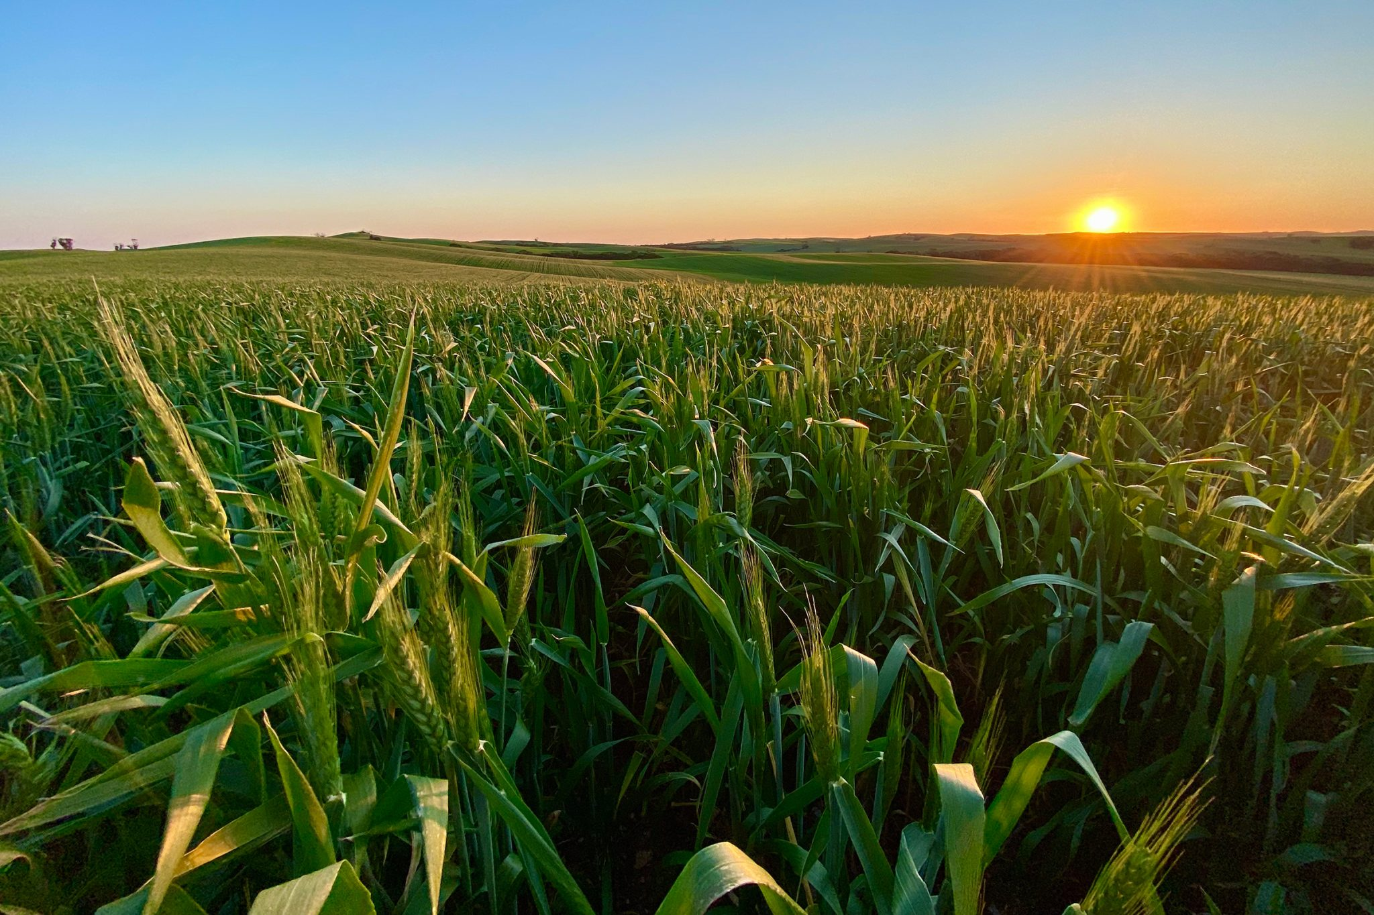
Current biosecurity systems …

Slide 7
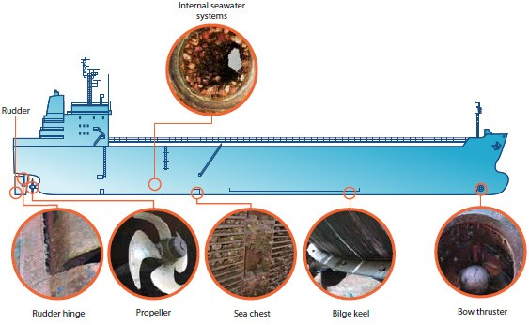
CEBRA 21C: biofouling risk insurance
Niche areas of ships often have high level of biofouling

Slide 8
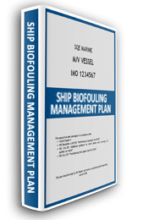
CEBRA 21C: biofouling risk insurance
  Biosecurity risk insurance mechanism:
  Vessel operators required to purchase biofouling risk insurance
    Premiums calculated by actuaries based on biofouling risk posed by vessels
  Link risk-rating to verifiable BMPs
    No verifiable BMPs = high risk, high premiums
    Incentives to reduce biofouling risk
  Insurance pool (accumulated premium payments)
    Funds biosecurity agency costs, incl surveillance
    Funds response effort
    Financially sustainable model

Slide 9
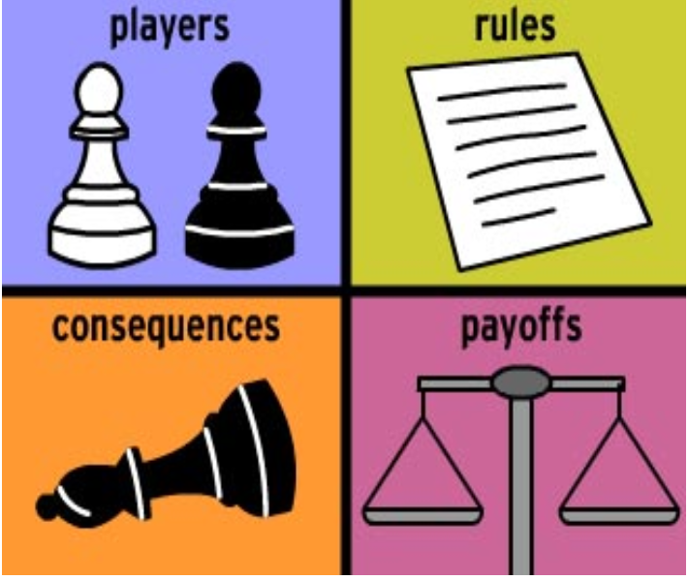
Conclusion
  Consider strategic risks, and use the disciplines best placed to do this
    Actuaries, (market design) economists …
  Technology for verification and detection is very important
  Creating fair, efficient and sustainable biosecurity systems is a multi-disciplinary task

Slide 10
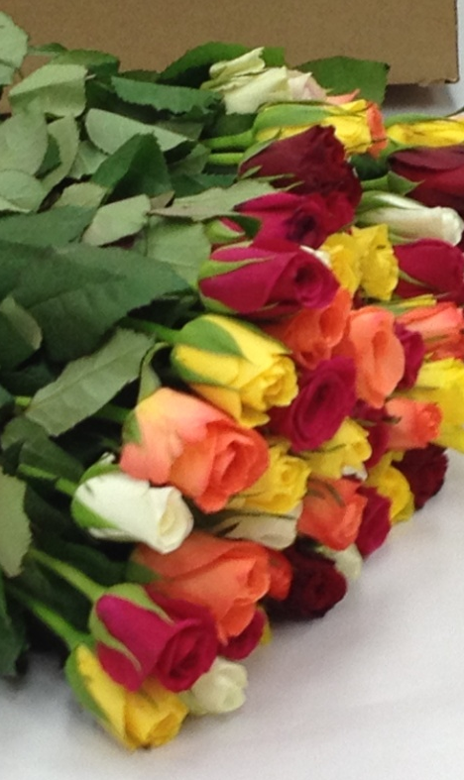
Acknowledgements
Peter Wilkinson, Tim Carew (DAFF)
Dan Presser, Rachelle Clarke, Holly Blackwood, Connie de Marco (DAFF)
Eugene Georgiades
The University of New England, Armidale

Slide 11
Sources
Stoneham, G., Hester, S.M., Li, J., Zhou, R. and Chaudhry, A. 2021 The boundary of the market for biosecurity risk insurance. Risk Analysis, 41(8), 1447-1462. https://doi.org/10.1111/risa.13620
Pictures:
https://www.logupdateafrica.com/three-real-solutions-for-shortage-of-air-capacity-for-flowers-aviation
https://www.larthur.com.au/biosecurity-and-customs.html
https://www.marinepests.gov.au/pests/identify/northern-pacific-seastar
https://mbacc.com.au/2018/04/18/tax-stats-reveal-the-state-of-the-australian-community/
https://www.marinetraffic.com/en/ais/details/ships/shipid:5630138/mmsi:353136000/imo:9811000/vessel:EVER_GIVEN
https://towardsdatascience.com/what-data-scientists-should-know-about-game-theory-types-of-games-2ecc616ea725
https://www.brisbanetimes.com.au/national/queensland/what-panama-disease-tr4-means-for-australias-bananas-20151207-glh8uw.html
https://www.graincentral.com/property/telusa-to-test-appetite-for-eyre-peninsula-cropping-country/

