Slide 1
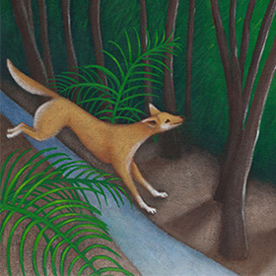
Environmental biosecurity – beyond the matrix
Terry Walshe
The Centre of Excellence for Biosecurity Risk Analysis (CEBRA) is an Australian Government initiative

Slide 2
Many people helped. Thanks!
Chantel van Wamalen, Butchulla Land and Sea Rangers
Linda Behrendorff, Queensland Department of Environment and Science
Sue Sargent, Fraser Island Natural Integrity Alliance
Geoff Pegg, Queensland Department of Agriculture and Fisheries
Peter Shooter, Fraser Island Defenders Organisation
Miles Broome, Butchulla Land and Sea Ranger
Trent Juster , Queensland Department of Resources
Don Bradley, Sandy Cape Lighthouse Conservation Association
Lesley Bradley, Sandy Cape Lighthouse Conservation Association
Jenn Firn, Queensland University of Technology
Lyn Wallace, Queensland Department of Environment and Science
Colin Zemek, Fraser Coast Council
Jason Reberger, Queensland Department of Resources
Tom Kompas, Andrew Robinson and Kelly de Bie, CEBRA
Ian Thompson, Elyse Herrald-Woods and Andrew Pearce at the Environmental Biosecurity Office.
Illustration by Tania Erzinger from the book Dingo in the Dark, written by Sally Morgan.

Slide 3
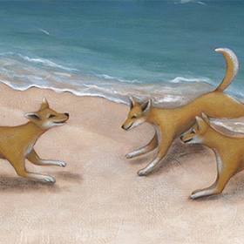
outline
Prefacing comments
Decision support
Risk assessment
Over to you – Q & A and discussion around adoption
Illustration by Tania Erzinger from the book Dingo in the Dark, written by Sally Morgan.

Slide 4
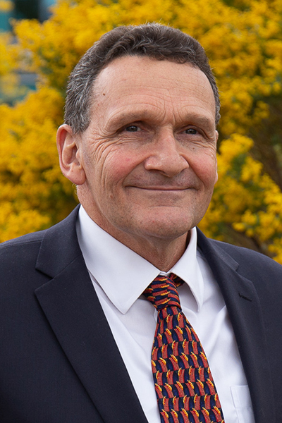
1. prefacing comments – origins of the project
Ian Thompson, (former) Chief Environmental Biosecurity Officer

Slide 5
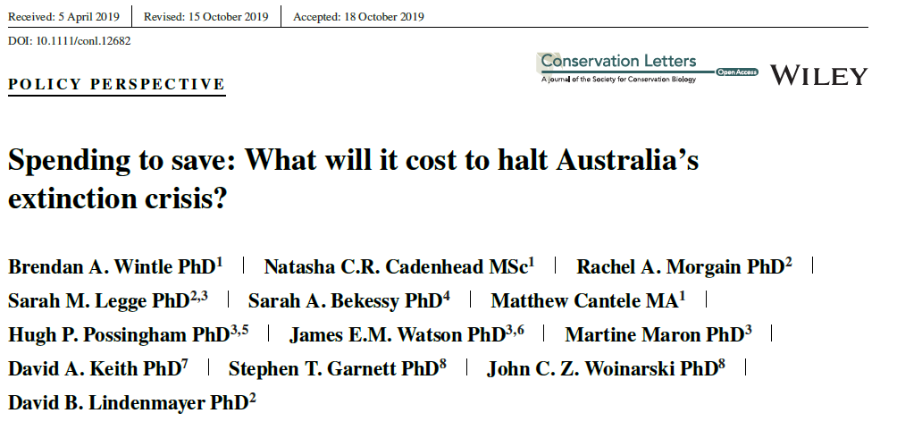
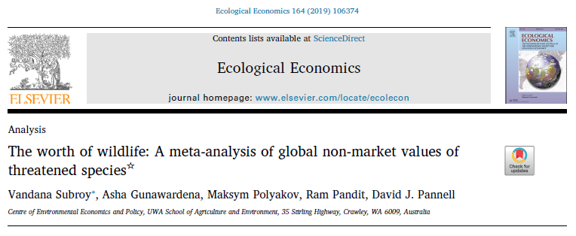
1. prefacing comments – conservation need not be small fry
…by collating disparate published budget figures of Australian governments, we show that annual spending on targeted threatened species recovery is around U.S.$92m (AU$122m)…about 15% of what is needed to avoid extinctions and recover threatened species…
Clustered robust meta-regression analysis is applied to 109 willingness to pay (WTP) estimates for threatened species from 47 stated-preference studies in 19 countries….Average total present value of WTP was $414/household (in 2016 US dollars)…

Slide 6
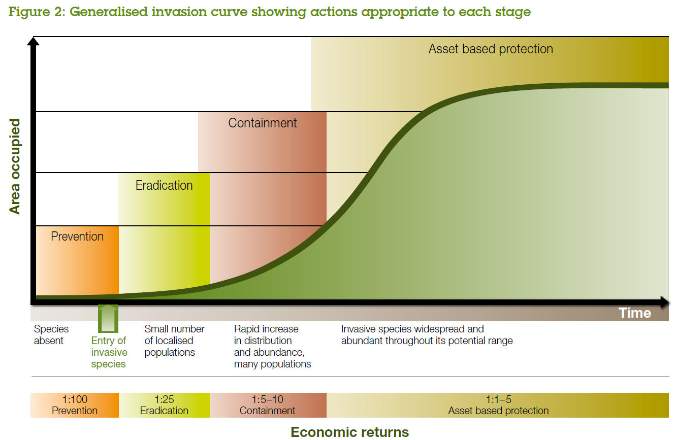
Source: Biosecurity Victoria (2010) Invasive Plants and Animals Policy Framework

Slide 7
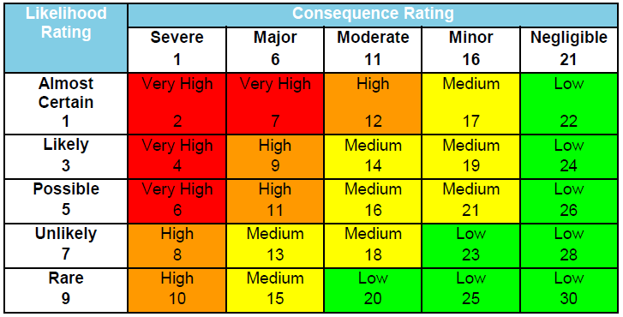
1. prefacing comments – the risk matrix is a shabby tool for assessing the merit of investment in biosecurity
Applications typically
assess risk posed by a set of pests and pathogens in the absence of additional measures
identify risks that are considered intolerable
identify actions that might help mitigate these risks
What’s often missing is
an account of the aggregate risk to key values from multiple pests
estimates of the effectiveness of actions, and their costs
Source: AECOM (2016). Lord Howe Island Biosecurity Strategy 2016.

Slide 8
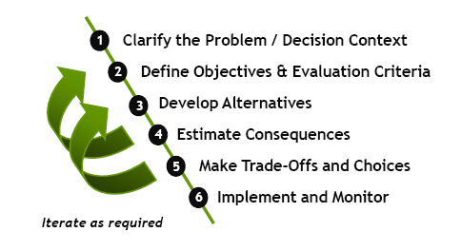
2. decision support
Structured decision-making
A formalization of common sense for decision problems which are too complex for informal use of common sense.

Slide 9
2. decision support - objectives
Objective | Attribute | Preference direction
Rainforest - OUV (vii, viii, ix) | Index of adverse impact | less is better
Heath - OUV (ix) | Index of adverse impact | less is better
Perched lakes - OUV (vii, viii) | Index of adverse impact | less is better
Fens - OUV (ix) | Index of adverse impact | less is better
Butchulla connection to country | Person days/yr on country as a proportion of ask | more is better
Butchulla economic opportunity | $k/yr work done by Butchulla Rangers as a proportion of ask | more is better
Impact on visitor experience | Constructed scale | less is better
(Cost of risk mitigation measures) | ($M) | (Less is better)

Slide 10
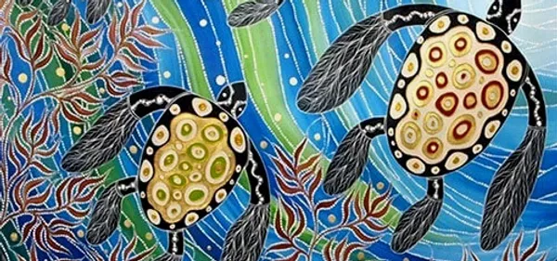
2. decision support - alternatives
Quarantine
Level 1 | status quo | Five inspection events per year at Riverheads.
Level 2 | very lite | Inspection point at Riverheads that is attended for all barge departures during school holidays. Inspections for visitors.
Level 3 | lite | Washdown bays at Riverheads. Voluntary wash down of vehicles. Inspection points that are attended for all barge departures during school holidays. Inspections for visitors.
Level 4 | medium | Washdown bay and boot washing station at Riverheads and Inskip Point. Compulsory washdown of vehicles and boots before entering barge. Formalised inspection points that are attended for all barge departures (peak). Inspection of all vehicles (visitors, residents and commercial). Inspections at boat ramps in peak times.
Level 5 | heavy | Formal terminus at Inskip Point. Multiple vehicle washdown bays and boot washing stations at Riverheads and Inskip Point. Compulsory washdown of vehicles and boots before entering barge. Formalised inspection points that are attended for all barge departures (peak and off peak). Inspection of all vehicles (visitors, residents, and commercial) and high-risk equipment. Inspections at boat ramps at times.
Source: Butchulla Native Title Aboriginal Corporation website
www.bntac.com
…and five levels for education and enforcement, and five levels for search and destroy.

Slide 11
2. decision support – the burden of inputs
So in total we have 5 × 2 × 5 × 2 × 5 × 2 = 1,000 alternatives!
That’s a lot of alternatives that require assessment of (likelihood ×) consequence.
Together with trade-offs describing the context-specific importance of the objectives, the analyst needs to gather estimates of
the probability of entry, establishment and spread, and the consequences of spread for each of the 20 worry list pests
the cost of each of the five levels of candidate investment in quarantine, education and search and destroy, and
the effectiveness of each of the five levels of candidate investment in quarantine, education and search and destroy.
The computer does the rest!

Slide 12
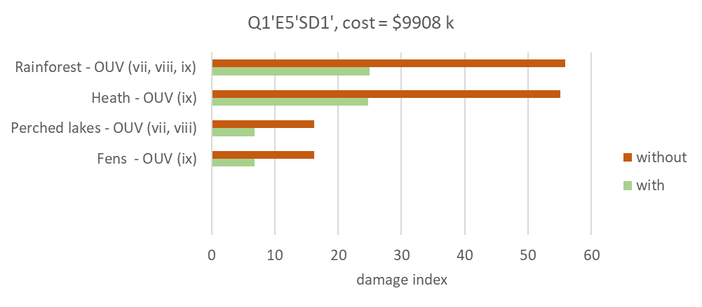
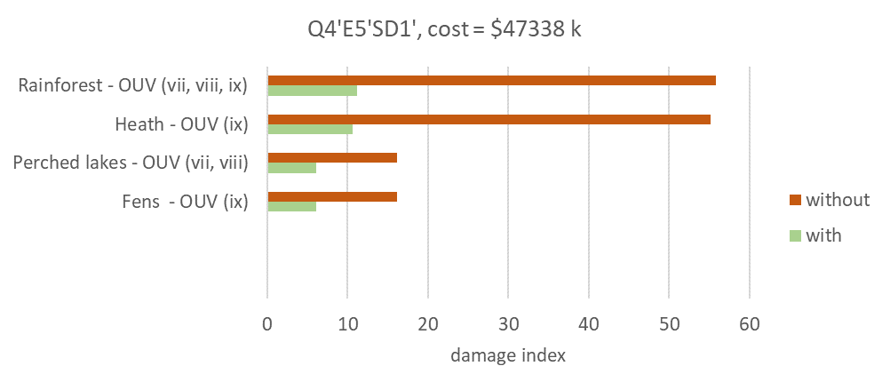
2. decision support – outputs
A common feature of the planning context is that managers do not have a strong sense of what budget may be available for biosecurity management. Often, resource availability depends on
the magnitude of risks under current management,
the prospect for material improvement in risk with action and associated additional resourcing,
broad agreement among key stakeholders about how risk is to be mitigated, and
the ability to communicate these things clearly to those responsible for allocating resources within organisations.
A
B
A
B

Slide 13
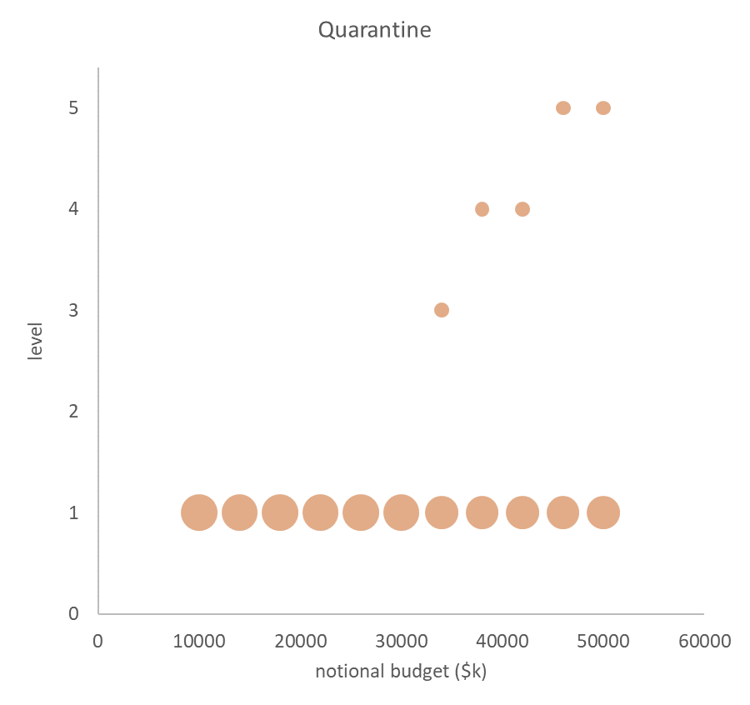
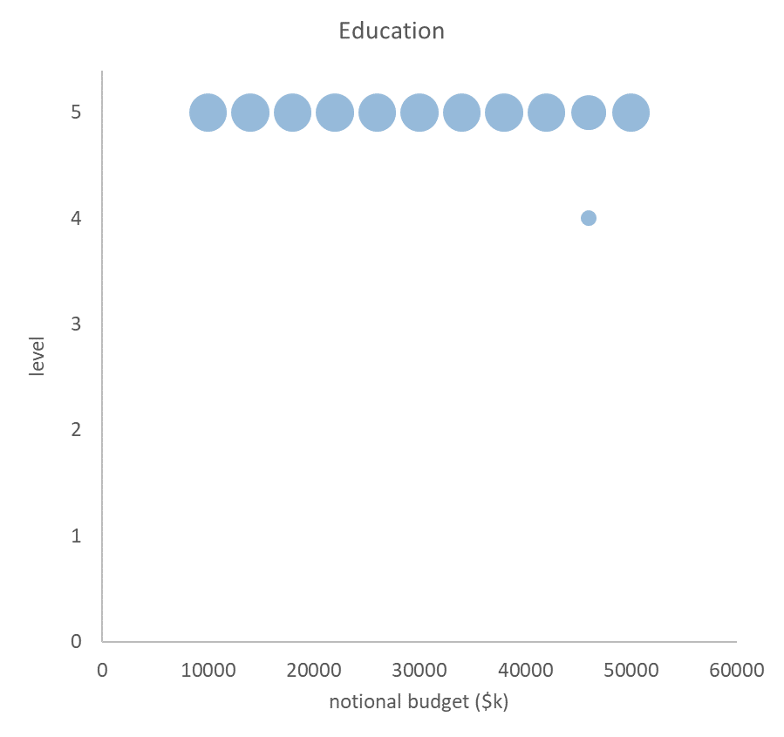
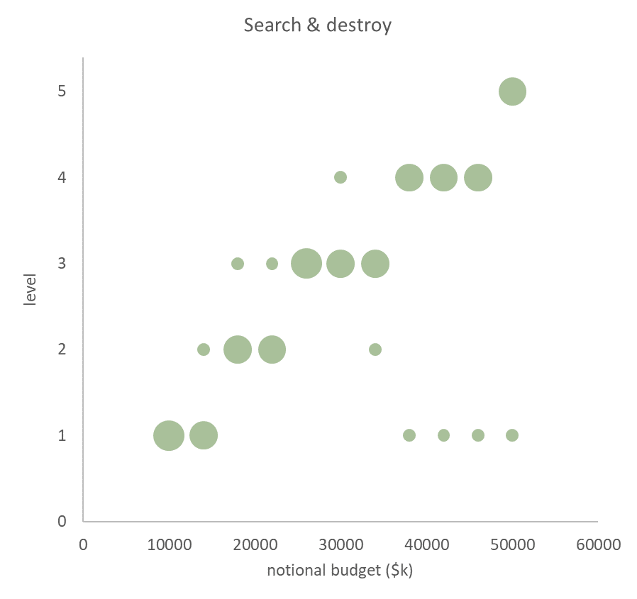
2. decision support – outputs

Slide 14
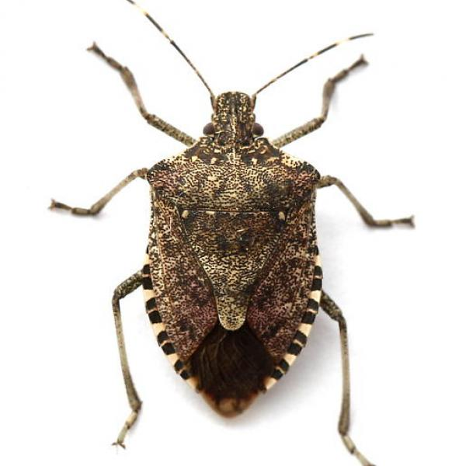
3. risk assessment – worry list (for K’gari)
Ceratocystis wilt (Ceratocystis manginecans and other exotic Ceratocystis spp.)
Exotic strains of myrtle rust (Austropuccinia psidii)
Polyphagous shot hole borer associated fusarium wilt (Fusarium euwallaceae)
Phytophthora spp
Phytophthora ramorum
P. multivora
P. cinnamomi
Chytrid fungus (Batrachochytrium dendrobatidis)
Tramp ants
Red imported fire ant (Solenopsis invicta)
Electric ant (Wasmannia auropunctata)
Yellow crazy ant (Anoplolepis gracilipes)
Brown marmorated stink bug (Halyomorpha halys)
Bitou bush (Chrysanthemoides monilifera subsp. rotundata)
Aquatic weeds
Duckweed (Lemna disperma)
Water hyacinth (Eichhornia crassipes)
Cabomba - Cabomba caroliniana.
Peruvian Primrose (Ludwigia peruviana)
Cat’s claw (Uncaria tomentose)
Mosquitofish (Gambusia holbrooki and Gambusia affinis)
Tilapia (several spp)
Domestic dogs
Over a specified time horizon,
probability of entry
probability of establishment|entry
probability of spread|establishment, and
consequences|spread

Slide 15
3. risk assessment – conceptual models

Slide 16
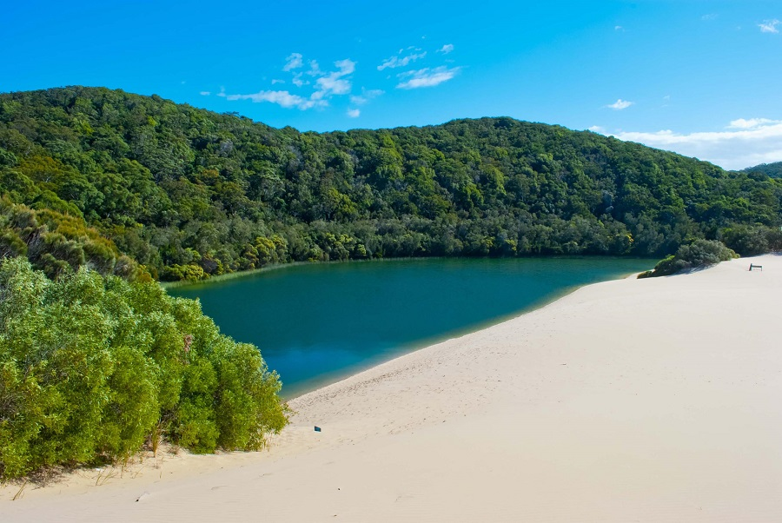
3. risk assessment – consequences for conservation values
Source: Queensland Parks and Wildlife Service

Slide 17
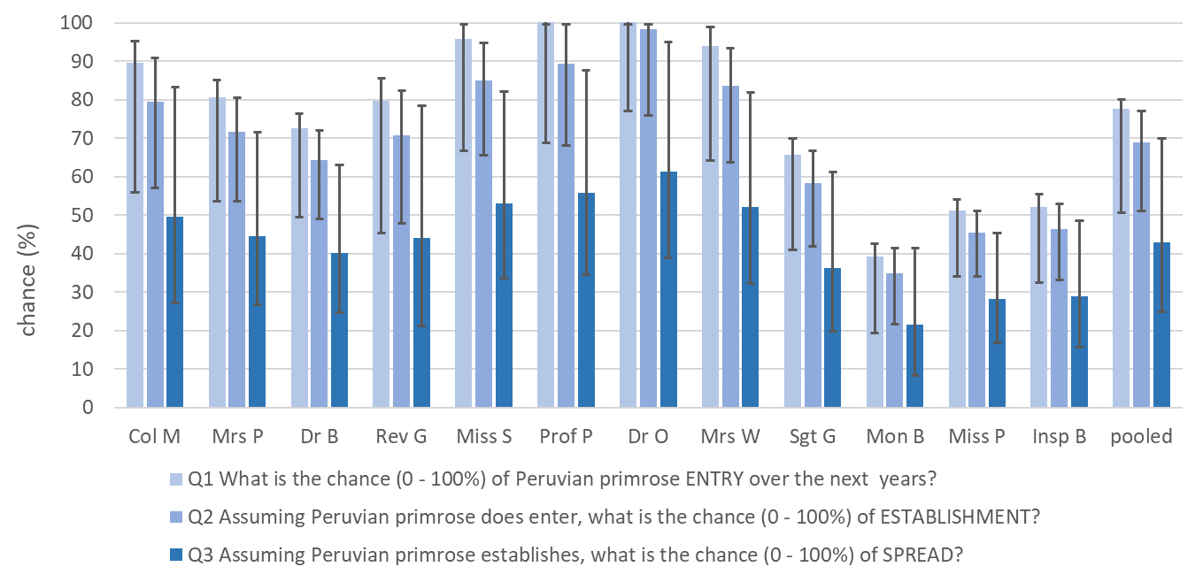
3. risk assessment – expert judgment

Slide 18
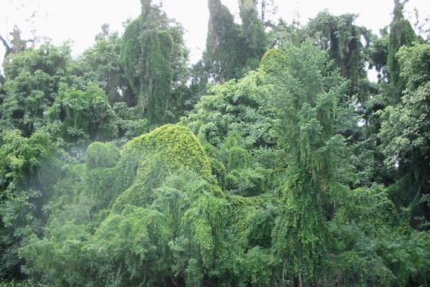
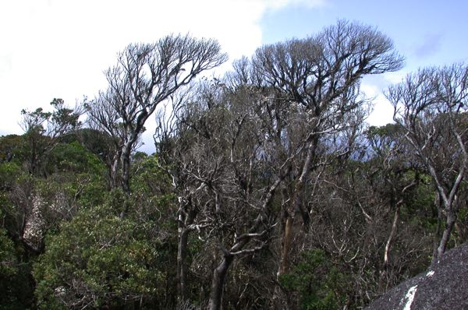
3. risk assessment – simplifying assumptions
To estimate aggregate risk over multiple pests we assume impacts are independent…
Cats claw Phytophthora
E × E × S × consequence AND E × E × S × consequence Aggregate risk = 100 × (0.18 + 0.46 – 0.18 × 0.46) = 56
0.9 × 0.5 × 0.8 × 50 = 18 0.95 × 0.9 × 0.6 × 90 = 46
Source:https://weeds.brisbane.qld.gov.au/weeds/cats-claw-creeper
https://www.wettropics.gov.au/phytophthora-cinnamomi

Slide 19
3. risk assessment – simplifying assumptions
The point(s) at which actions reduce risk is stripped back…

Slide 20
The project report and excel-based tools are available at
https://cebra.unimelb.edu.au/engage/reports/decision-making
Note that the approach and tools are not limited to islands or World Heritage Areas. With minor modification they can be used for any conservation reserve, terrestrial or marine.
Illustration by Tania Erzinger from the book Dingo in the Dark, written by Sally Morgan.

Slide 21
over to you
Witty questions and fumbling answers
Discussion
Would you use this?
What needs to happen to make it readily useable?
Illustration by Tania Erzinger from the book Dingo in the Dark, written by Sally Morgan.

